Slide 1
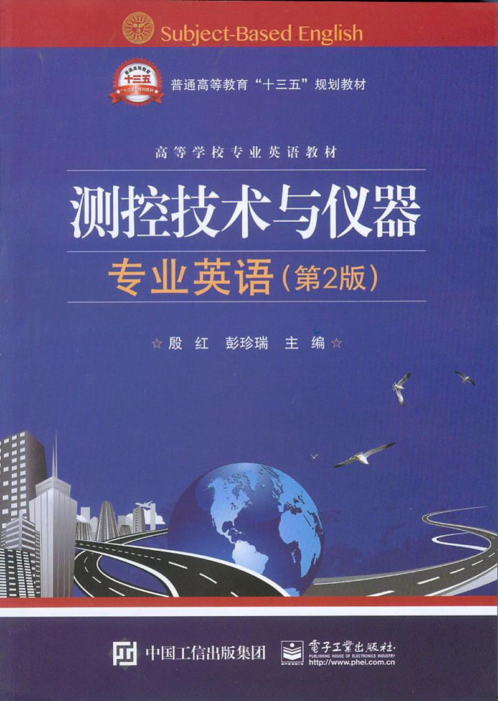
Unit12 Artificial Intelligence

Slide 2
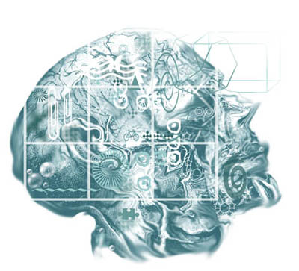
Unit12 Artificial Intelligence

Slide 3
The field of computer science known as artificial intelligence (AI) (人工智能) attempts to develop computer systems that can mimic (模仿) or simulate human senses, thought processes, and actions. These include reasoning, learning from past actions, and using senses such as vision and touch.
被称为人工智能(AI)的计算机科学领域试图发展计算机系统，使之能够模仿人类感官，思想过程和行为。包括从过去的行为中推理，学习，以及感官的运用，如视觉和触觉。

Slide 4
Artificial intelligence that corresponds to human intelligence is still a long way off. However, several tools that emulate (与……竞争，努力赶上) human senses, problem solving, and information processing have been developed.
然而，已经研发出了一些模仿人类感官，问题解决，信息处理的工具。

Slide 5
In the past, computers used calculating power to solve structured problems, which can be broken down into a series of well-defined steps. People—using intuition, reasoning , and memory—were better at solving unstructured problems, whether building a product or approving a loan.
在过去，计算机运用其计算能力解决结构化问题，结构化问题能分解成一系列明确的步骤。而人类运用直觉、推理和记忆，能更好地解决非结构化问题，或是生产一个产品，或是批准一个贷款。

Slide 6
Organizations have long been able to computerize the tasks once performed by clerks. Now knowledge-intensive (知识密集型的)work and unstructured problems, such as activities performed by many managers, are being automated.
在过去很长的时间里，如果工作由工人个人完成，企业可以借助计算机完成任务。现在知识密集型工作和非结构化问题都可以自动完成，如由多名管理者一起完成的活动。

Slide 7
Let us now consider three areas in which human talents and abilities have been enhanced with “computerized intelligence”: virtual reality, knowledge-based systems, and robotics.
让我们来考虑这样三个领域，在这些领域中人类的天赋和才能因计算机智能而得以提高：虚拟现实、基于知识的系统和机器人技术。

Slide 8
Virtual reality
Suppose you could create and virtually experience any new form of reality you wished. You could see the world through the eyes of a child, a robot—or even a lobster . You could explore faraway resorts, the room, or inside a nuclear waste dump without leaving your chair. This simulated experience is possible with virtual reality.
假定你能创造并虚拟体验一个你想要的新的现实形式。你能够通过一个孩子的，机器人的——甚至一个龙虾的眼睛看世界。你不用离开你的座位就可以探索遥远的风景，房间，或核废料排放场的内部。这些模拟体验都可以在虚拟现实中完成。

Slide 9
Virtual reality (虚拟现实)is an artificial, or simulated, reality generated in 3-D by a computer. Virtual reality is also commonly known as VR, artificial reality(人工现实), or virtual environments(虚拟环境). To navigate in a virtual space, you use virtual reality hardware including head -gear and gloves.
虚拟现实是由计算机3-D技术产生的人工的仿真的现实。虚拟现实也通常称为VR，人工现实，或虚拟环境。为了操纵虚拟空间，你使用的虚拟现实硬件有帽子和手套。

Slide 10
The headgear has earphones and three-dimensional stereoscopic screens (one type is called Eyephones ) . The gloves have sensors that collect data about your hand movements ( one type is called Data Glove ).
句中Eyephone是计算机用语，指“眼机(用于虚拟现实)，视像耳机”。DataGlove指“（装有传感器的）数据手套”。
全句译为：帽子上有耳机和三维立体屏（一种类型是视像耳机）。手套上有传感器，采集手运动的数据（一种类型是数据手套）。

Slide 11
Coupled with software (such as a program called Body Electric), this interactive sensory equipment lets you immerse yourself in a computer-generated world.
Body Electric是美国VPL Research公司开发的用于虚拟现实设计的可视化程序设计语言。
全句译为：再加上软件（如Body Electric系统），这种交互式感知装置能让你置身于计算机生成的世界中。

Slide 12
Creating virtual reality programs required very-high-end(很高档的) software costing several thousands of dollars. Recently, several lower-cost yet powerful authoring programs have been introduced. These programs are widely used to create Web-based virtual reality applications. One of the best known is Cosmo Worlds (是可视化的VRML编器 )from Cosmo Software (美国硅图公司SGI的多媒体软件子公司).
创建虚拟现实程序一度需要非常高端的软件，需要花费几千美元。近来，也引进了几款较便宜的有效的权威程序。这些程序利用VRML语言，广泛应用于创建基于Web的虚拟现实应用。其中最有名的是Cosmo Software公司的Cosmo Worlds软件。

Slide 13
Modern virtual reality strives to be an immersive experience, (沉浸式体验) allowing a user to walk into a virtual reality room or view simulations on a virtual reality wall,(沉浸式体验) as shown in Figure 12.1.
现代虚拟现实力求做到沉浸式体验，允许用户走进虚拟现实房间或观看虚拟现实墙上的场景仿真。

Slide 14
Knowledge-Based (Expert) Systems
These system use a database, or knowledge base, that contains specific facts, rules to relate these facts, and user input to formulate recommendations and decisions.The sequence of processing is determined by the interaction of the user and the knowledge base. Many expert systems use so-called fuzzy logic（模糊逻辑）, which allows users to respond to questions in a very humanlike way.
这些系统使用数据库，或知识库，知识库包含具体事实，关联事实的规则，制定建议和决策的用户输入。处理顺序取决于用户和知识库的交互。许多专家系统运用所谓的模糊逻辑，允许用户用类似人类的思想方法思考问题。

Slide 15
Robotics
Robotics is the field of study concerned with developing and using robots. Robots are computer-controlled machines that mimic the motor activities of living things.
Honda’s Asimo robot日本本田公司在2000年研制的人形机器人阿西莫（Asimo），是人形机器人的代表作，是世界上第一个双足自行直立行走的仿人机器人 。
全句译为：机器人技术是关于开发和使用机器人的研究领域。机器人是计算机控制的机器，它模仿生命事物的运动神经活动。

Slide 16
For example, Honda’s Asimo robot, as shown in Figure 12.3, resembles a human and is capable of walking upstairs, dancing, shaking hands, and much more.
如本田公司的阿西莫机器人，如图12.3所示，它就像人类一样，能够走上楼梯，跳舞，握手，以及做更多动作。

Slide 17
1．Perception system robots
Perception system robots (感知系统机器人) imitate some of the human senses. For example, robots with television-camera vision systems (电视摄像视觉系统) are particularly useful. They can guide machine tools, inspect products, and secure homes.
感知系统机器人模仿人类的一些感官。如，具有电视摄像视觉系统的机器人特别有用。它们能引导机床，检验产品，监测家庭安全。

Slide 18
2．Industrial robots
Industrial robots (工业机器人) are used to perform a variety of tasks. Examples are machines used in auto- mobile plants to do welding, polishing, and painting. Some types of robots have claws for picking up objects and handing dangerous materials.
工业机器人用于完成各种任务。如汽车工厂中用于焊接、抛光和喷漆的机器。有些类型的机器人有卡爪，用于抓起物体，传递有危险性的材料。

Slide 19
3．Mobile robots
Mobile robots act as transports and are widely used for a variety of different tasks. For example, the police
and military use them to locate and disarm(解除、消除) explosive devices. Mobile robots have entered the world of entertainment with their own television program called Battlebots（指“机器人大战”，是世界上转播最多的机器人比赛）. You can even build your own personal robot using special robot building kits.
移动机器人起到运输的作用，广泛用于各种不同的任务。如，警察和军队用它们来定位和解除爆炸装置。移动机器人进入娱乐圈，有它们自己的电视节目，叫做机器人大战。你甚至可以用专用的机器人成套组件构建你自己的个人机器人。

